Slide 1
ADS FINAL PROJECT
TEAM 8
RUI SHEN
HANAN ALSALAMAH
DIVYA MALVIYA
ADBHUT SANGAL

Slide 2
OBJECTIVES
PART 1:
Run neural networks on Prudential Insurance dataset
PART 2:
Fit Convolutional Neural Network (CNN) to Semeion Handwritten Digit Data by finding the optimum number of hidden layers and related nodes

Slide 3
PART 1
NEURAL NETWORK
ON
PRUDENTIAL DATASET

Slide 4
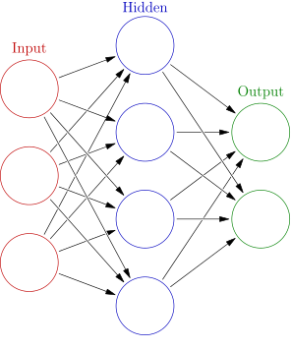
NEURAL NETWORKS
Neural Network is a non-linear model characterized by an activation function, which is used by interconnected information processing units to transform input into output.
The layers:
The input layer connects with hidden layer/s, which in turn connects to the output layer.

Slide 5
PRUDENTIAL DATA ANALYSIS
The data contains 110 categorical variables, 13 continuous variables and 5 discrete variables
Categorical variables contain a finite number of categories, such as (Product_Info_2)
Discrete variables are numeric variables that have a countable number of values between two values, such as (Medical_History_10)
Continuous variables are numeric variables that have an infinite number of values between two values, such as (BMI)

Slide 6
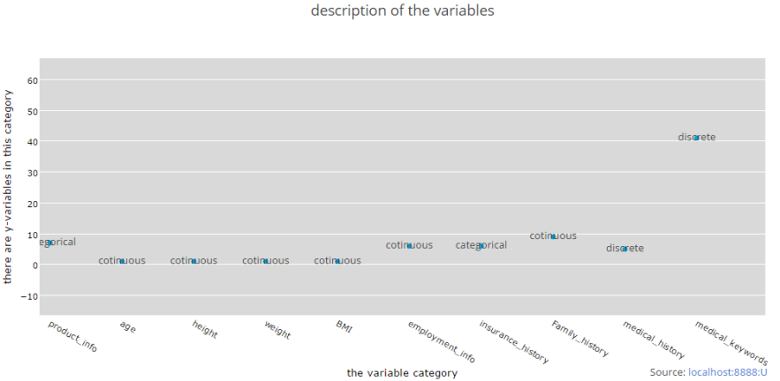
PREDICTIVE VARIABLES

Slide 7
DATA PREPARATION AND TRANSFORMATION
Removing the columns that have more than or equal 70% of null values; and removing unnecessary Id column
Replacing the null values in each column with the computed mean of that column
Setting categorical columns to as a factor to get factors with n levels
Converting the categorical columns into dummy variables using 1 to C method
Fitting the linear regression model and taking the significant variables only

Slide 8
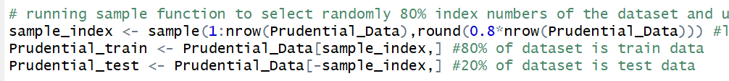
MODEL 1: NEURAL NETWORK MULTINOMIAL CLASSIFICATION
Converting each level of "Response" categorical column into dummy variables using 1 to C method
Scaling the 10 Continuous variables using Min-Max Normalization to be between 0 and 1
Splitting dataset into train and test datasets using sample function

Slide 9
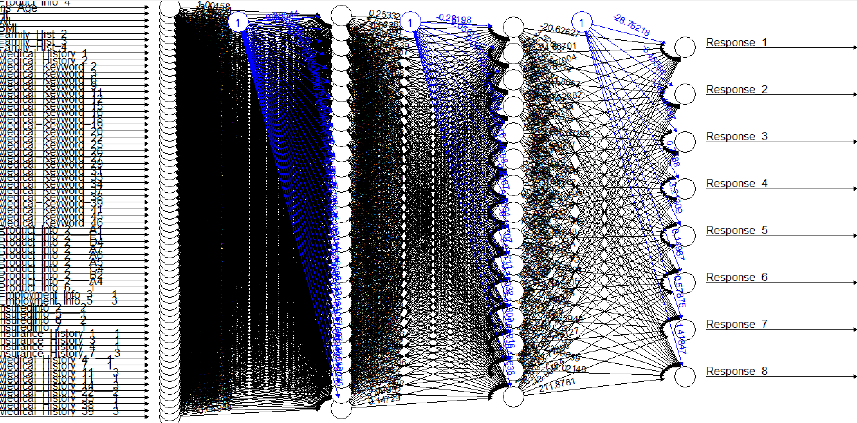
MODEL 1: NEURAL NETWORK MULTINOMIAL CLASSIFICATION
Fitting Neural Network on train dataset by choosing the hidden layer to be ⅔ of the input size.
Plotting the results

Slide 10
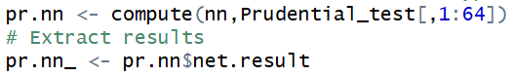
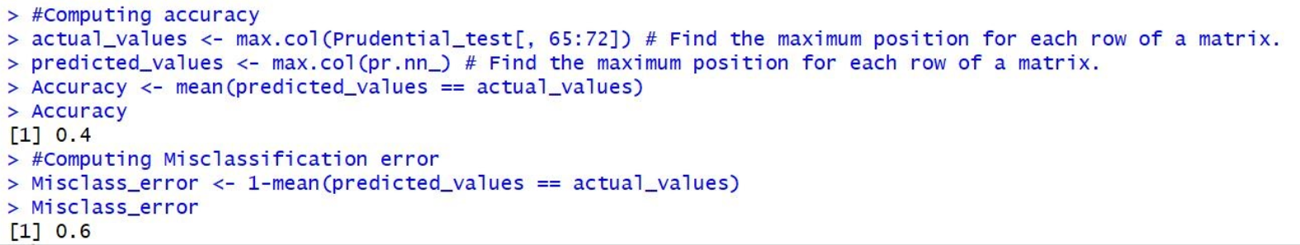
MODEL 1: NEURAL NETWORK MULTINOMIAL CLASSIFICATION
Computing predictions for multi-class classification.
The typical approach is to have ‘n’ output neurons represent the different classes
In the end, the neuron which has the highest prediction 'wins' and that class is predicted
Computing the accuracy and the misclassification error
´

Slide 11
MODEL 1: NEURAL NETWORK MULTINOMIAL CLASSIFICATION
Hidden Layers:
Hidden Layers | (27,15) | (23,19)
Accuracy | 40% | 41%
Misclassification Error | 60% | 59%

Slide 12
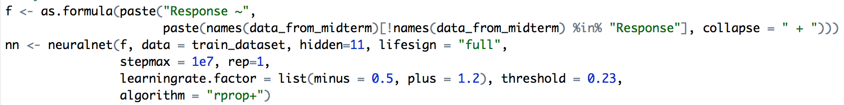
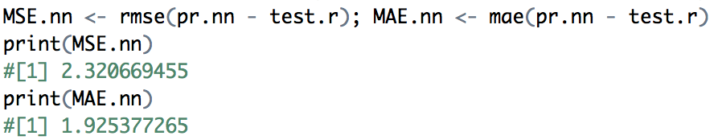
MODEL 2: NEURAL NETWORK REGRESSION
Scale the dataset and split it into train and test data
Set parameters and train the train dataset
Evaluate the performance

Slide 13
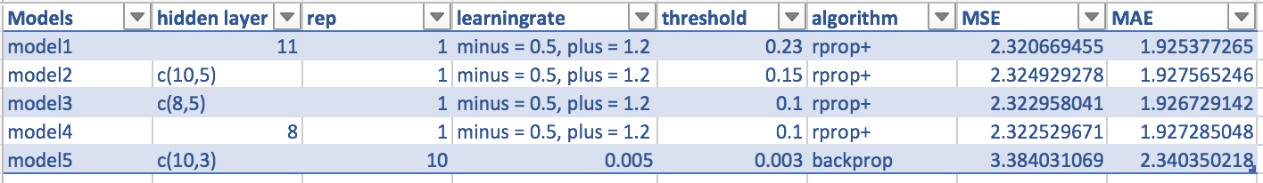
MODELS AND SUMMARY

Slide 14
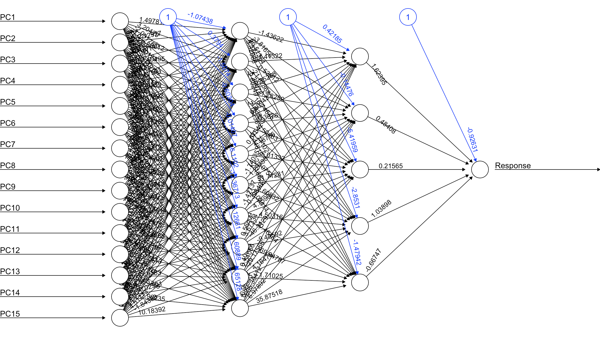
DEMO PLOT OUTPUT

Slide 15
CONVOLUTIONAL
NEURAL
NETWORK
PART 2

Slide 16
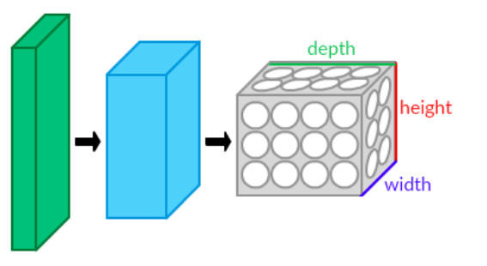
CONVOLUTIONAL NEURAL NETWORK
Convolutional neural network is a class of deep, feed-forward artificial neural networks that has successfully been applied to analyzing visual imagery.
A CNN consists of an input and an output layer, as well as multiple hidden layers
The layers of a CNN typically consist of
Convolutional Layer
Pooling Layer
Dropout Layer
Fully connected Layer
´

Slide 17
SEMEION DATA ANALYSIS
Data Set Characteristics: Multivariate
Number of Instances: 1593
Number of Attributes: 256
Associated Tasks: Classification
1593 handwritten digits from around 80 persons were scanned, stretched in a rectangular box 16x16 in a gray scale of 256 values.
Then each pixel of each image was scaled into a boolean (1/0) value using a fixed threshold.
Each person wrote on a paper all the digits from 0 to 9, twice- first time in the normal way and the second time in a fast way

Slide 18
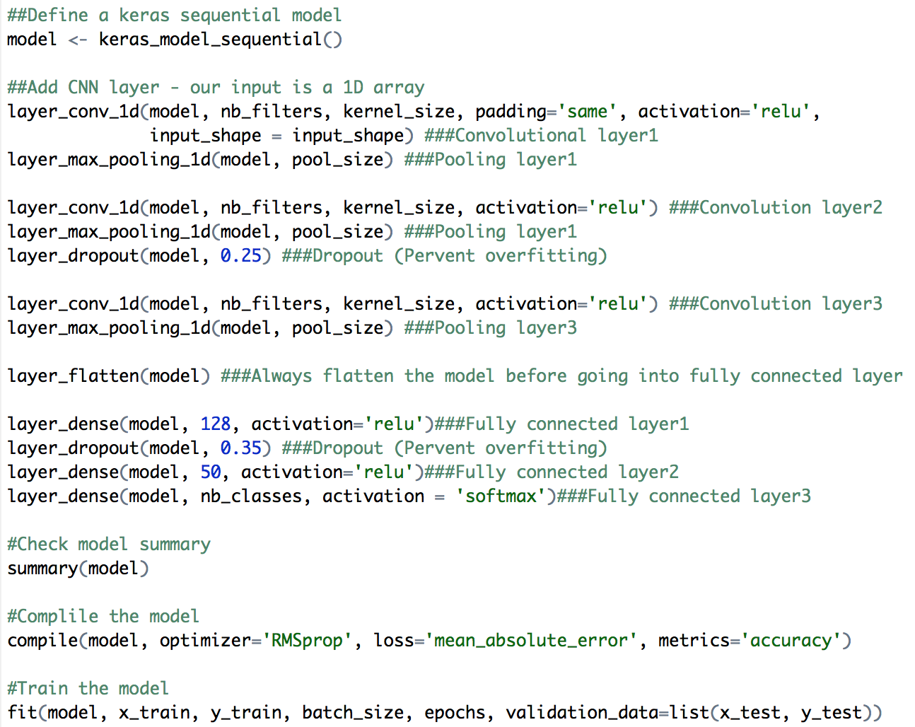
PROCESS AND CODE
Setup keras environment in R
Read semeion dataset
Split into train and test dataset
Add CNN layers

Slide 19
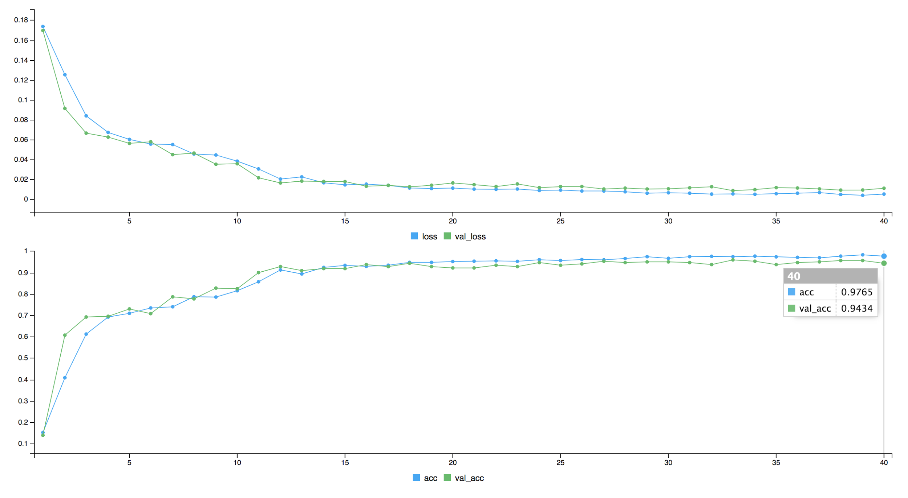
SAMPLE OUTPUT

Slide 20
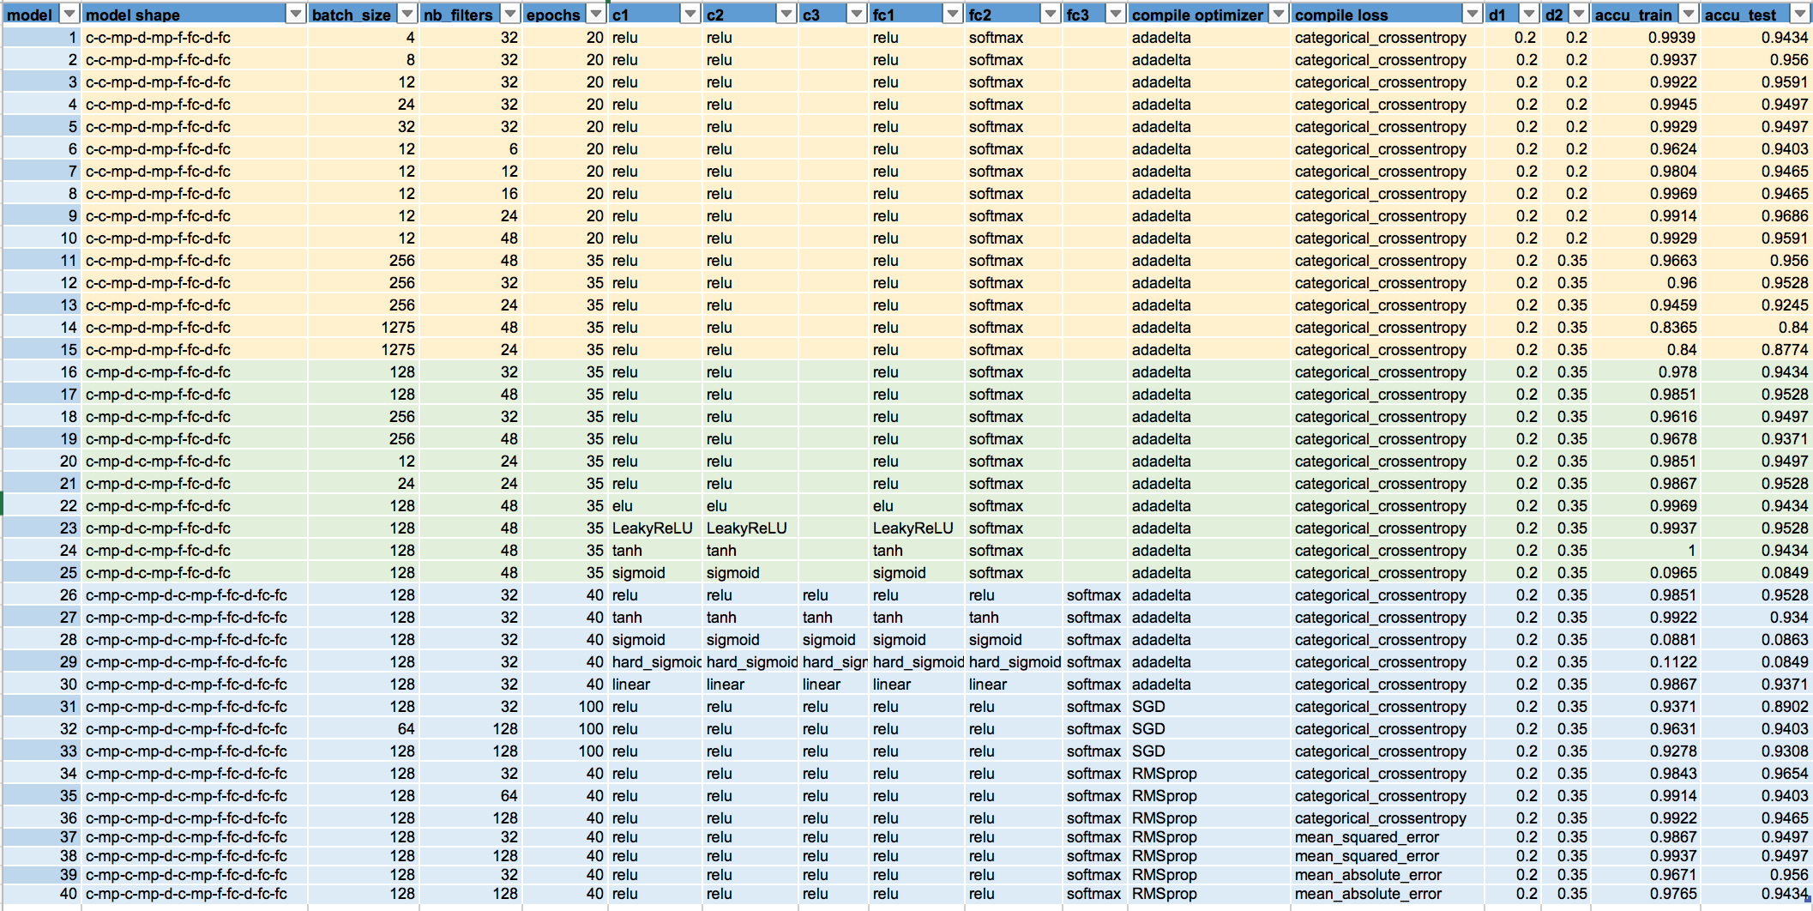
MODELS AND SUMMARY

Slide 21
CONCLUSION & FUTURE WORK
NEURAL NETWORK:
Less variables reduce the runtime
Each dataset has different parameters and algorithms that works best
CONVOLUTIONAL NEURAL NETWORK:
Data is the key
FUTURE WORK:
deepnet and mxnet Package
h20 package
MULTINOMIAL CLASSIFICATION | REGRESSION
Takes longer time to process | Processes in shorter time
Result is straightforward | Requires additional operations

